Slide 1

Microsoft SharePoint Sites Part II
mintesnot

Slide 2

What is a SharePoint Site?
Key differences Classic Vs Modern
Key Features
Components of SharePoint
Integrate with Microsoft 365 Ecosystem
SharePoint Version Evolution
Types of SharePoint Users
SharePoint Admin Center
SharePoint Vs OneDrive

Slide 3

SharePoint Modern Sites
SharePoint in Microsoft 365 offers two primary modern site templates: Team Sites and Communication Sites.
Both support modern pages, web parts, responsive design, and powerful customization, but they serve fundamentally different purposes.
Core Philosophy:
Team Sites: ” “Where the work gets done” – private, collaborative, workspaces.
Communication Sites: “Where information is shared” – broadcasting and storytelling platforms.
Important Note: You cannot easily convert one site type to the other after creation. Planning the purpose upfront is critical.

Slide 4
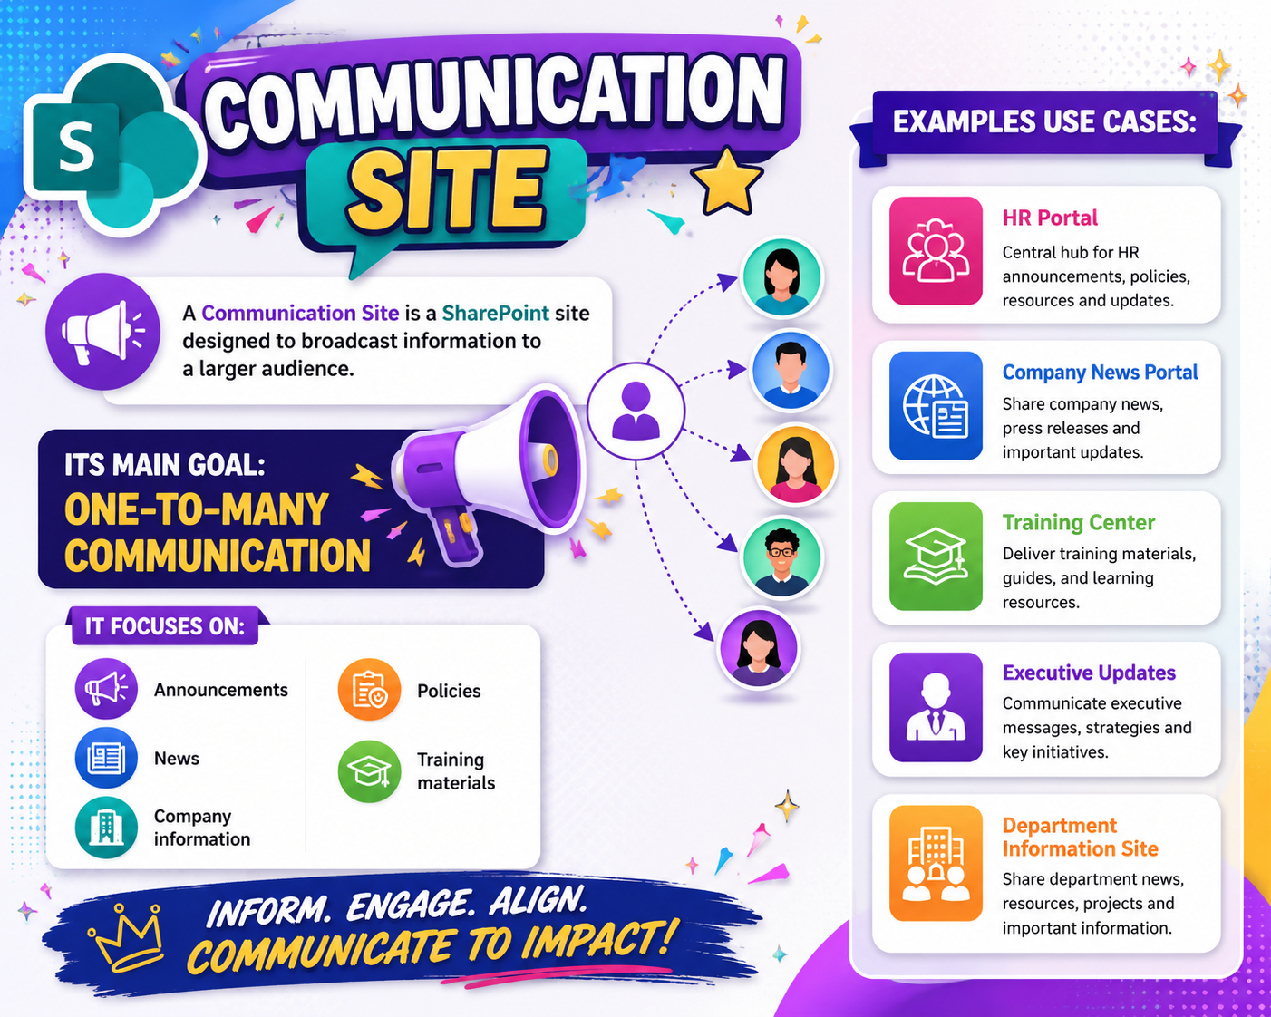

What is a Communication Site?
A Communication Site is a SharePoint site designed to broadcast information to a larger audience.
Its main goal is One-to-many communication.
It focuses on:
Announcements
News
Company information
Policies
Training materials
Examples Use Cases:
HR Portal
Company News Portal
Training Center
Executive Updates
Department Information Site

Slide 5
Characteristics of Communication Sites
Few Content Creators
Only selected users publish content.
Large Audience
Many employees consume information.
Attractive Design
Modern layouts and visual pages
Read-Oriented
Focuses more on viewing than editing
Organized information
Content categorized neatly

Slide 6
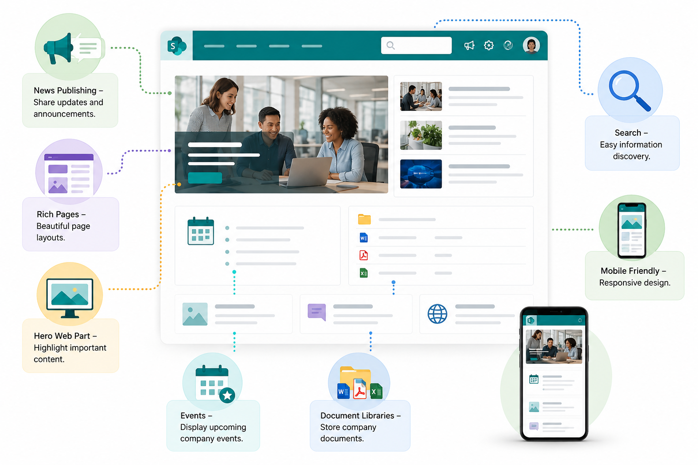
Features of Communication Sites
News Publishing – Share updates and announcements.
Rich Pages – Beautiful page layouts.
Hero Web Part – Highlight important content.
Events – Display upcoming company events.
Document Libraries – Store company documents.
Search– Easy information discovery.
Mobile Friendly – Responsive design.

Slide 7
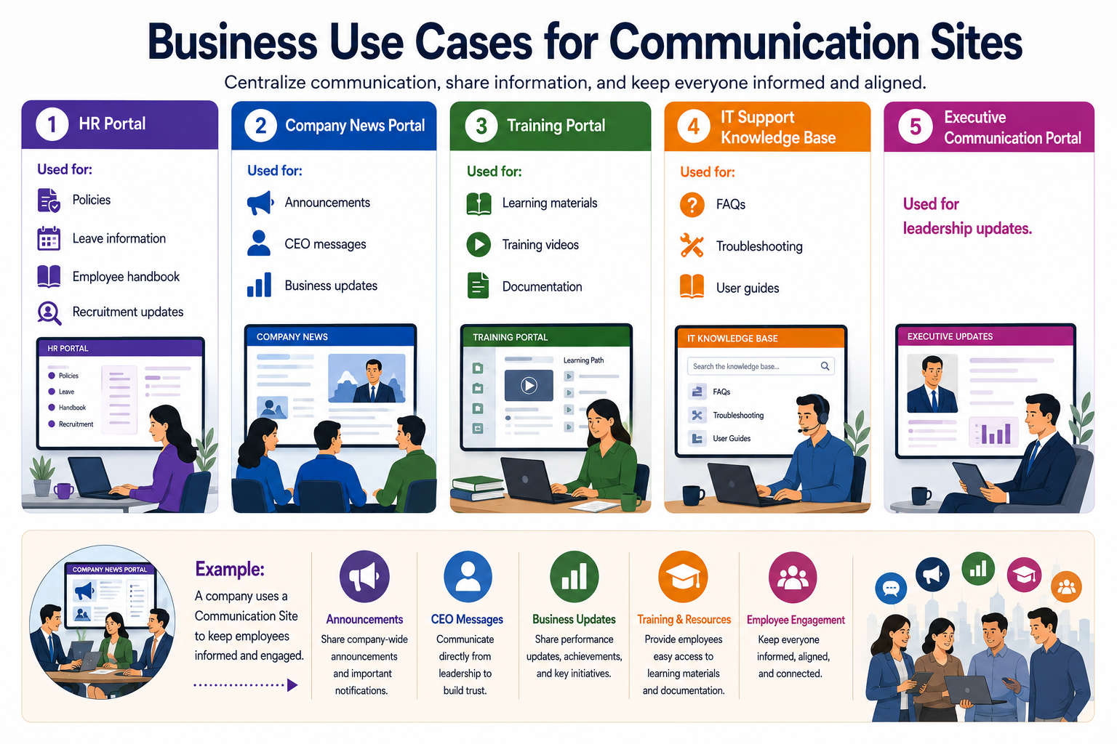
Real-world examples of Communication Sites

Slide 8
Limitations of Communication Sites
Limited Collaboration – Not ideal for teams actively working together.
Few Contributors – Usually only authorized users edit content.
Less Interactive – Employees mainly consume information.
Not Project-Oriented – Poor choice for project teamwork.
Avoid using Communication Sites For:
❌ Daily team collaboration
❌ Task management
❌ Team project work
❌ Heavy document co-authoring

Slide 9


What is a Team Site?
A Team Site is a SharePoint site designed for collaboration among team members.
Its main goal is Many-to-many collaboration.
It focuses on:
Share files
Edit documents
Manage tasks
Communication
Track progress
Examples Use Cases:
Project teams
IT department
Marketing team
Finance department
Student group projects

Slide 10
Characteristics of Team Sites
Collaborative Environment
Everyone works together.
Shared Ownership
Members can contribute content.
Document Co-Authoring
Multiple users edit files simultaneously.
Permission-Based Access
Only team members access content.
Integration with Microsoft Teams
Supports meetings and chats.

Slide 11
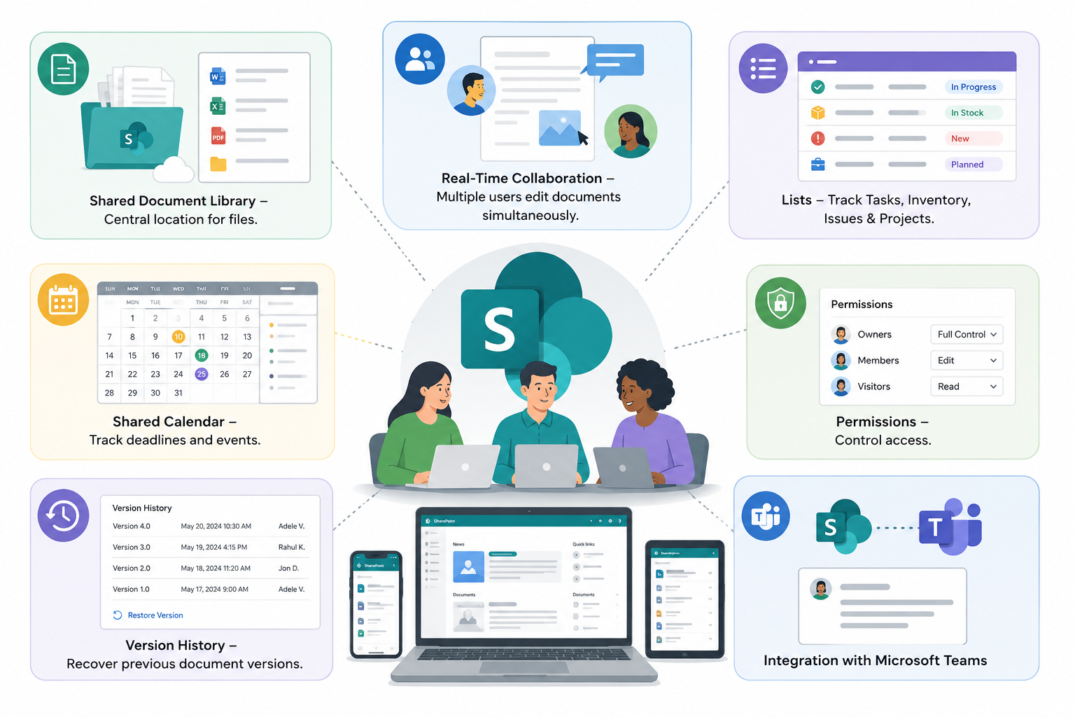
Features of Team Sites
Shared Document Library – Central location for files.
Real-Time Collaboration – Multiple users edit documents simultaneously.
Lists – Track Tasks, Inventory, Issues & Projects.
Shared Calendar – Track deadlines and events.
Permissions – Control access.
Version History – Recover previous document versions.
Integration with Microsoft Teams

Slide 12
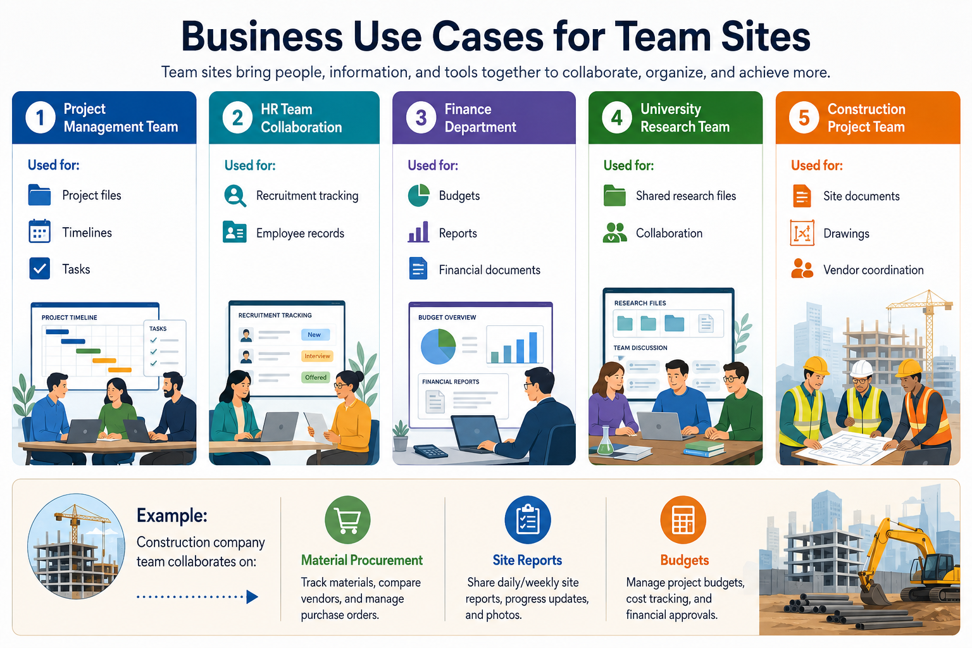
Real-world examples of Team Sites

Slide 13
Limitations of Team Sites
Can Become Disorganized – Poor governance causes clutter.
Too Many Permissions – Complex access settings.
Storage Management – Unused files accumulate.
Requires User Training – Employees must understand collaboration rules.
Common Problems:
❌ Duplicate files
❌ Poor folder structure
❌ Permission confusion
❌ Unused content

Slide 14
Communication Site Vs. Team Site
Feature | Communication Site | Team Site
Primary Goal | Share information | Collaborate
Audience | Large audience | Small team
Contributors | Few | Many
Content Style | Publishing | Collaboration
Editing | Limited | Shared editing
Permissions | Controlled | Team-based
Microsoft 365 Group | Usually No | Usually Yes
Best For | News & announcements | Project teamwork

Slide 15
Detailed Feature Comparison
Feature | Team Site | Communication Site
Primary Goal | Collaboration (many-to-many) | Broadcasting (one-to-many)
Microsoft 365 Group | Yes (mailbox, calendar, Planner, Teams) | No
Default Audience | Closed / Private team | Broad / Organization-wide
Content Authors | All members by default | Limited authors (controlled)
Navigation | Left-hand (Quick Launch) | Top navigation only
Permissions Model | Microsoft 365 Groups (easier for teams) | SharePoint Groups (more granular)
External Sharing (Default) | Often enabled | Disabled
Visual Design | Functional & practical | Highly visual, full-width sections
News & Events | Supported | Optimized (better engagement tools)

Slide 16
…
Feature | Team Site | Communication Site
Additional Tools | Planner, OneNote, Shared Email | Hero web part, News carousel, Spotlight
Web Parts Availability | More collaboration – focused options | Stronger publishing options
Conversion Possible? | No | No

Slide 17

When to Choose a Team Site
When You need:
✅ Team collaboration
✅ Shared editing
✅ Project management
✅ Task tracking
✅ Department teamwork
✅ File collaboration
Example Scenarios: Marketing Team – Campaign collaboration, IT Team – System documentation, Construction Team – Project coordination.

Slide 18
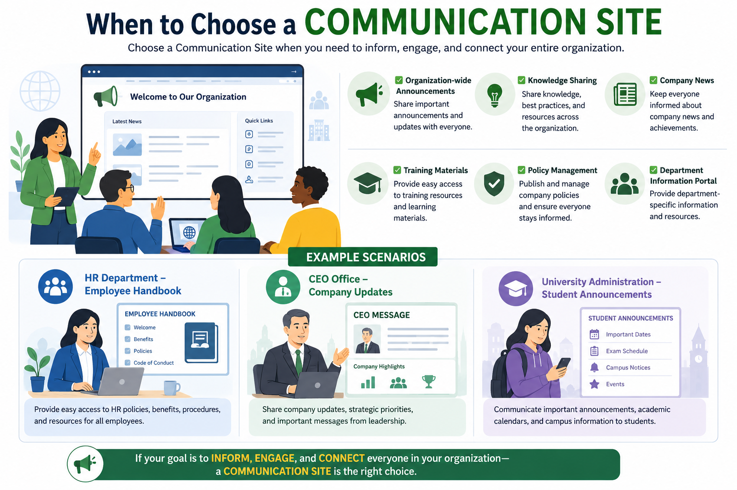
When to Choose a Communication Site
When You need:
✅ Organization-wide announcements
✅ Knowledge sharing
✅ Company news
✅ Training materials
✅ Policy management
✅ Department information portal
Example Scenarios: HR Department – Employee handbook, CEO Office – Company updates, University Administration – Student announcements.

